Slide 1


LUKLA
For a founder starting the climb
Notes:
Alon:
Hey we are Lukla!
A tool for young entrepreneurs like yourselves to help you become startup founders
Koren:
- Lukla is named after the Everest base camp where all climinbing begins,

Slide 2


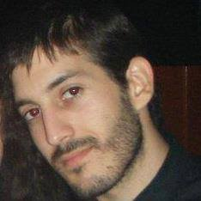

Te m
Koren Grinshpoon
Alon Grinshpoon
LL.M Candidate in Law
Columbia University
Former Associate
Herzog, Fox & Ne’eman
aka Legal Lord
MS Candidate in CS
Columbia University
Former Software Engineer
Mellanox Technologies
aka Code Commander
Notes:
Alon:
We are the grinshpoon brothers: Koren, LLM candidate at Colombia Law and Alon an Computer Science MS at Columbia Engineering

Slide 3

P IN
“This startup is so stealth, even the founders don’t know what they’re doing”
New founders
don’t know how to
kickstart their idea & launch new company
Notes:
Koren:
- How here wants to start there own company?
- How actually knows out a company is formed?

Slide 4


Web tool for founders aimed at
streamlining business management
Makes it easy for entrepreneurs to
establish, maintain and grow startups
Helps startups leaders looking to
understand and make decisions
Introducing an online platform for business insights
Notes:
Alon: Introducing Lukla, and online platform for new entrepreneurs that don’t have the knowledge to found a startup,
Koren: Read the slide.

Slide 5

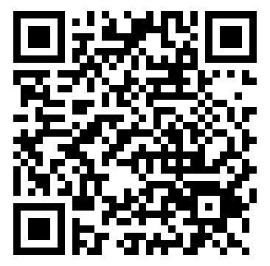

DEMO
http://lukla-devfest2017.azurewebsites.net/dashboard/index.html
Notes:
Alon & Koren:
Interactive
User-oriented
Helps provide an end solution
Lukla does the hard part of asking the right questions and basing the right business decisions based on the answers.

Slide 6

Founding a Company
Signing a Founders agreement
Opening a Bank account
Filing with tax authorities
Filing annual reports
Register a trademark
File provisional patent application
Drafting privacy policy
Notes:
Koren: Lukla has a lot of potential. We demonstrated what value Lukla can provide novice founders, yet there’s a lot more to explore.
Read the slide.

Slide 7

G IN
Learn the traits
Manage efficiently
Grow faster
Save time & money
Notes:
Alon: Lukla will teach how be a founder.
Koren: Read slide.

Slide 8
LUKLA

